Slide 1

Digital Signal Processing
Course Instructor
Dr. Ali J. Abboud
Lecture No. 2: Classification of DSP Systems
Third Class
Department of Computer and Software Engineering
http://www.engineering.uodiyala.edu.iq/
https://www.facebook.com/Engineer.College1

Slide 2
Lecture Outline
Classification of Signals
Basic Types of Digital Signals:
Unit Step
Impulse
Ramp
Exponential
Cosine
Classification of DSP Systems:
Causality
linearity
Time Invariant
Stability
Characterization of Digital Filters:
(1) Recursive (2) Non-Recursive
Dr. Ali J. Abboud

Slide 3




Classification of Signals
Multichannel and Multidimensional Signals
Dr. Ali J. Abboud

Slide 4
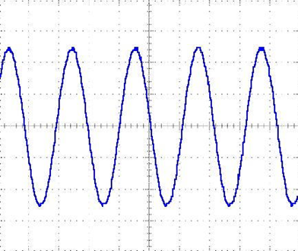

Classification of Signals
Continuous-Time and Discrete-Time Signals
Dr. Ali J. Abboud

Slide 5
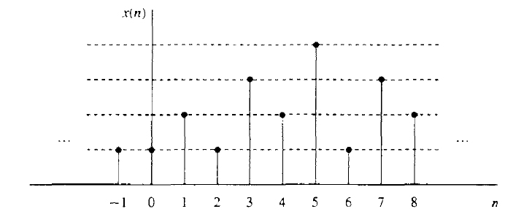
Classification of Signals
Continuous-Valued and Discrete-Valued Signals
Dr. Ali J. Abboud

Slide 6
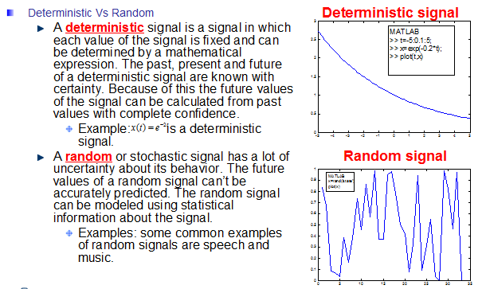
Classification of Signals
Deterministic and Random Signals
Dr. Ali J. Abboud

Slide 7
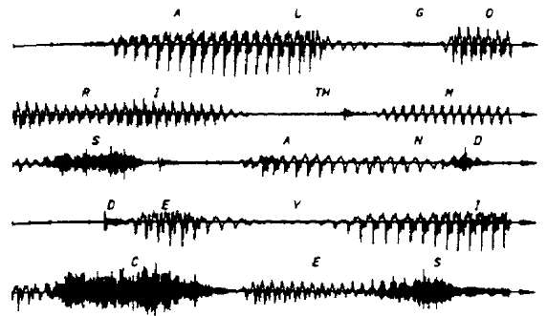
Classification of Signals
Deterministic and Random Signals
Dr. Ali J. Abboud

Slide 8
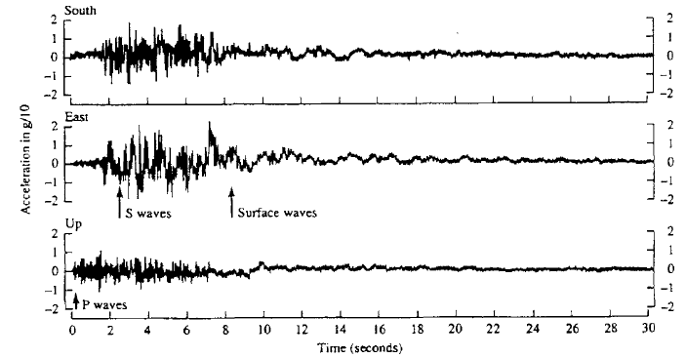
Classification of Signals
Deterministic and Random Signals
Dr. Ali J. Abboud

Slide 9
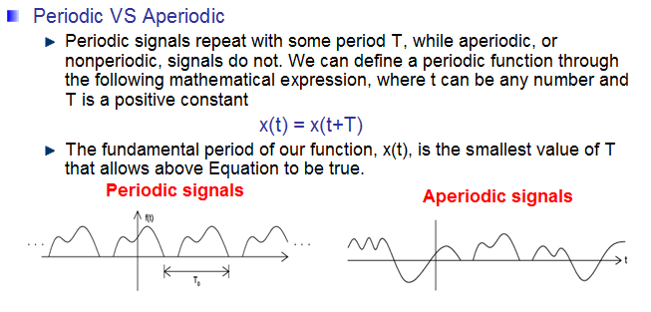
Classification of Signals
Peroidic and Aperoidic Signals
Dr. Ali J. Abboud

Slide 10
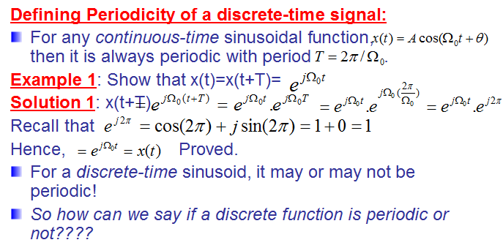
Classification of Signals
Peroidic and Aperoidic Signals
Dr. Ali J. Abboud

Slide 11
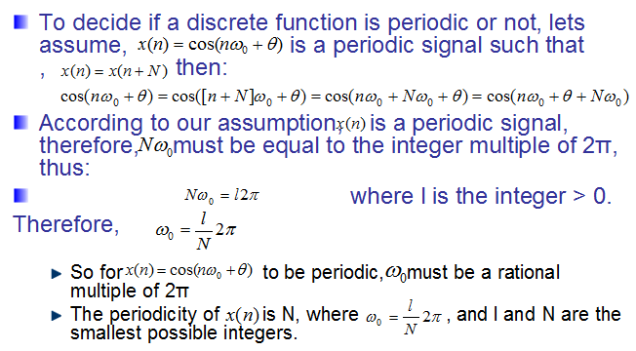
Classification of Signals
Peroidic and Aperoidic Signals
Dr. Ali J. Abboud

Slide 12
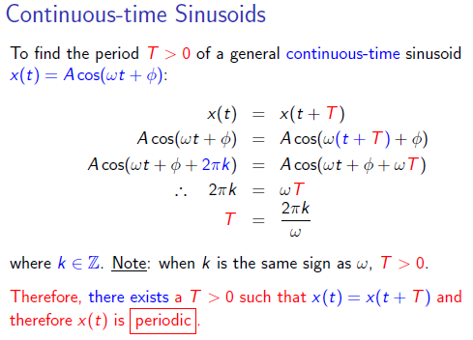
Classification of Signals
Discrete Time Sinusoids
Dr. Ali J. Abboud

Slide 13
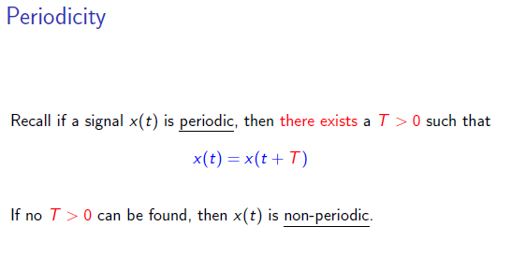
Classification of Signals
Discrete Time Sinusoids
Dr. Ali J. Abboud

Slide 14
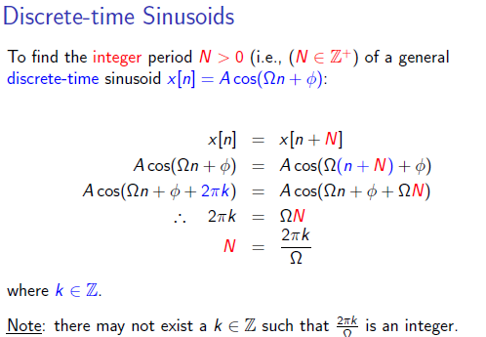
Classification of Signals
Discrete Time Sinusoids
Dr. Ali J. Abboud

Slide 15
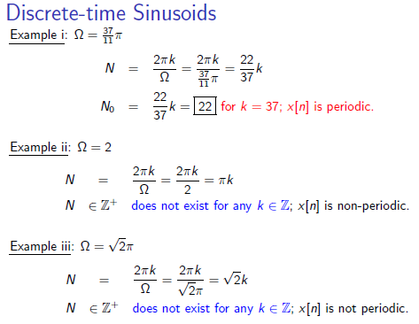
Classification of Signals
Discrete Time Sinusoids
Dr. Ali J. Abboud

Slide 16
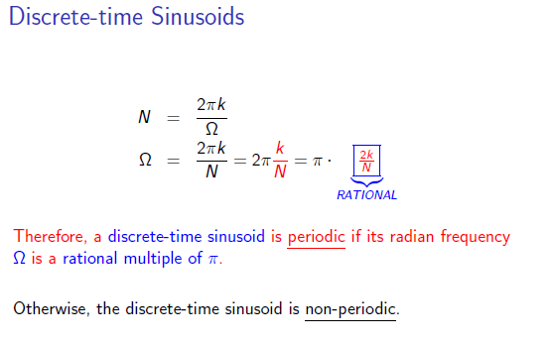
Classification of Signals
Discrete Time Sinusoids
Dr. Ali J. Abboud

Slide 17
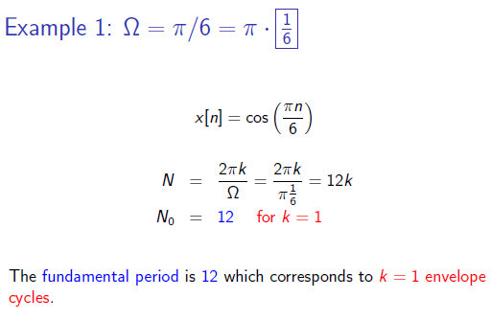
Classification of Signals
Discrete Time Sinusoids
Dr. Ali J. Abboud

Slide 18
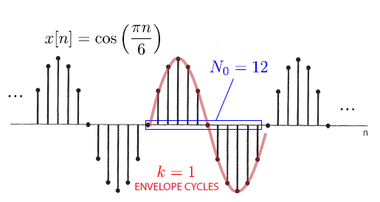
Classification of Signals
Discrete Time Sinusoids
Dr. Ali J. Abboud

Slide 19
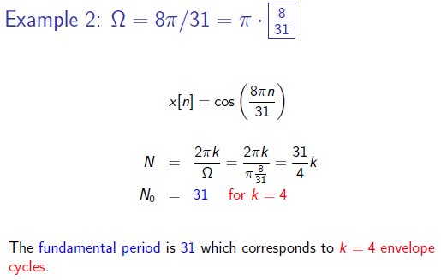
Classification of Signals
Discrete Time Sinusoids
Dr. Ali J. Abboud

Slide 20
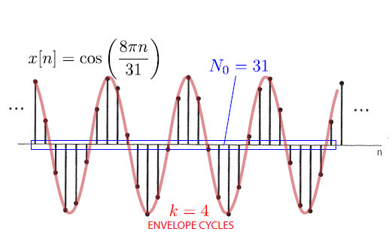
Classification of Signals
Discrete Time Sinusoids
Dr. Ali J. Abboud

Slide 21
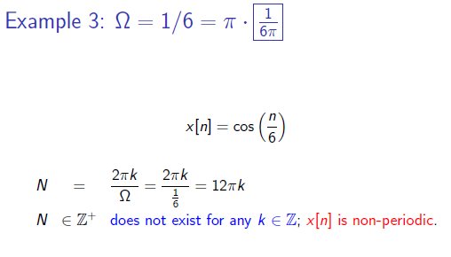
Classification of Signals
Discrete Time Sinusoids
Dr. Ali J. Abboud

Slide 22
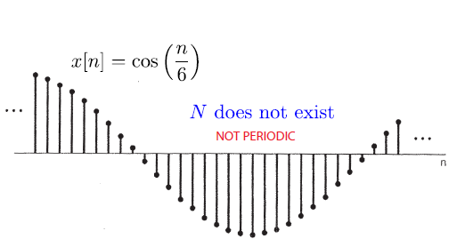
Classification of Signals
Discrete Time Sinusoids
Dr. Ali J. Abboud

Slide 23
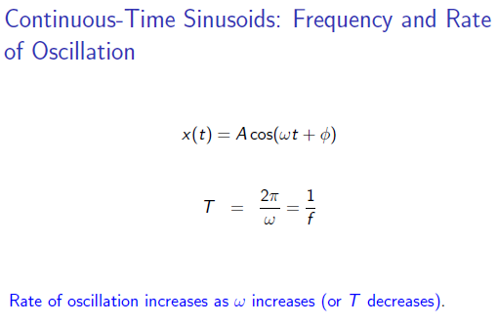
Classification of Signals
Discrete Time Sinusoids
Dr. Ali J. Abboud

Slide 24
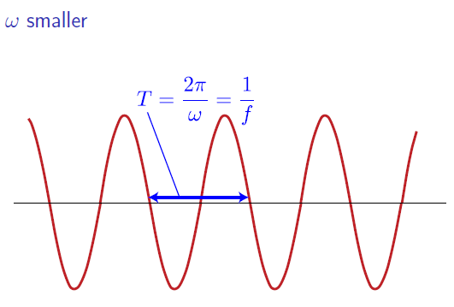
Classification of Signals
Discrete Time Sinusoids
Dr. Ali J. Abboud

Slide 25
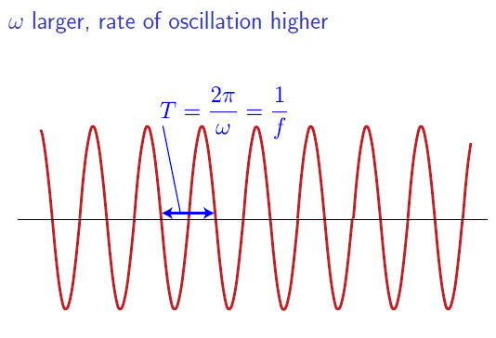
Classification of Signals
Discrete Time Sinusoids
Dr. Ali J. Abboud

Slide 26
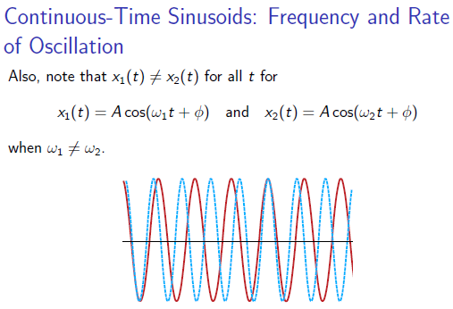
Classification of Signals
Discrete Time Sinusoids
Dr. Ali J. Abboud

Slide 27
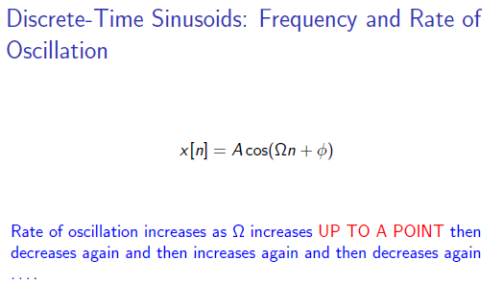
Classification of Signals
Discrete Time Sinusoids
Dr. Ali J. Abboud

Slide 28
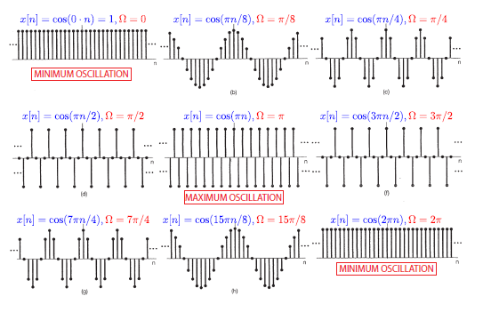
Classification of Signals
Discrete Time Sinusoids
Dr. Ali J. Abboud

Slide 29
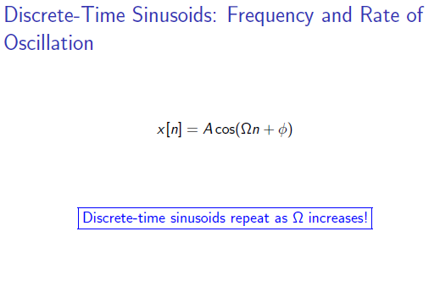
Classification of Signals
Discrete Time Sinusoids
Dr. Ali J. Abboud

Slide 30
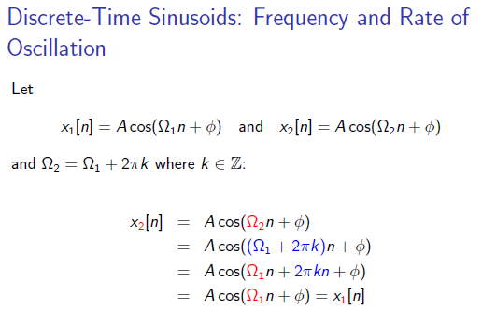
Classification of Signals
Discrete Time Sinusoids
Dr. Ali J. Abboud

Slide 31
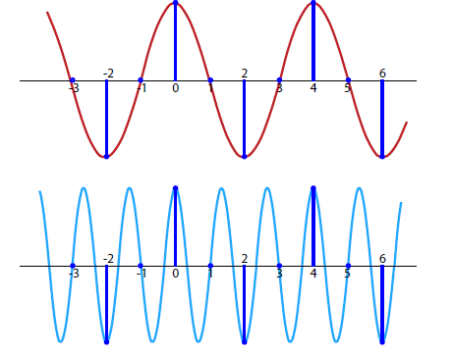
Classification of Signals
Discrete Time Sinusoids
Dr. Ali J. Abboud

Slide 32
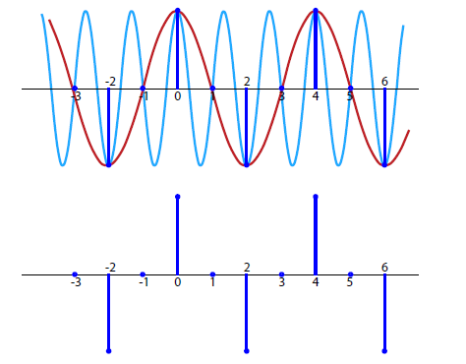
Classification of Signals
Discrete Time Sinusoids
Dr. Ali J. Abboud

Slide 33
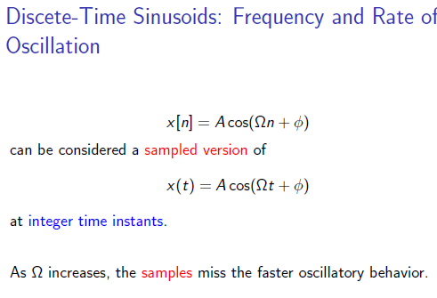
Classification of Signals
Discrete Time Sinusoids
Dr. Ali J. Abboud

Slide 34
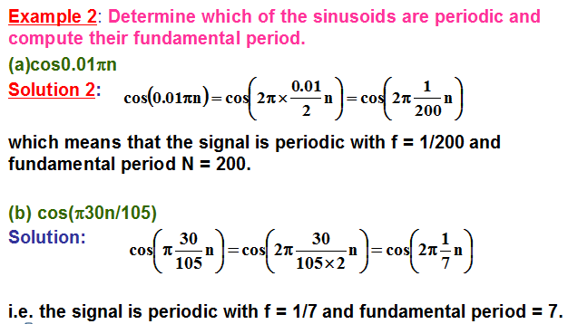
Classification of Signals
Peroidic and Aperoidic Signals
Dr. Ali J. Abboud

Slide 35
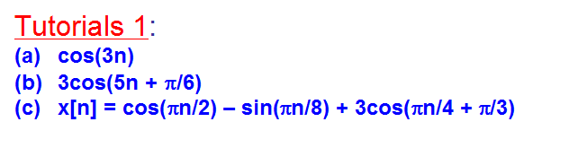
Classification of Signals
Peroidic and Aperoidic Signals
Dr. Ali J. Abboud

Slide 36
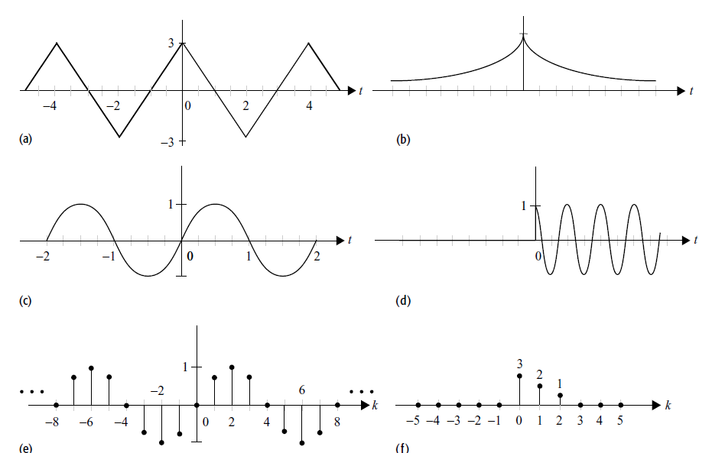
Classification of Signals
Peroidic and Aperoidic Signals
Dr. Ali J. Abboud

Slide 37
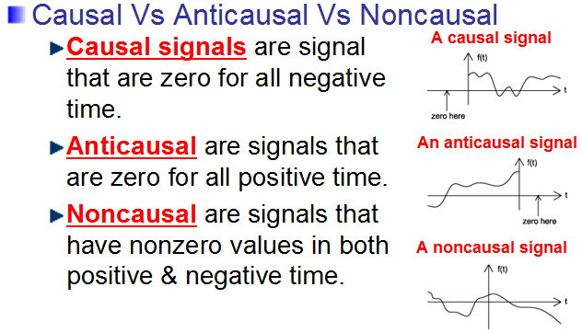
Classification of Signals
Causal Vs. Anticausal Vs. Noncausal
Dr. Ali J. Abboud

Slide 38
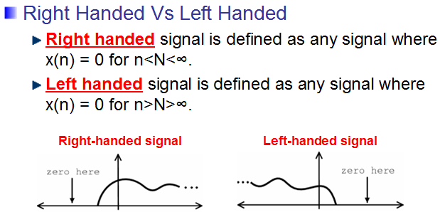
Classification of Signals
Right Handed Vs. Left Handed
Dr. Ali J. Abboud

Slide 39
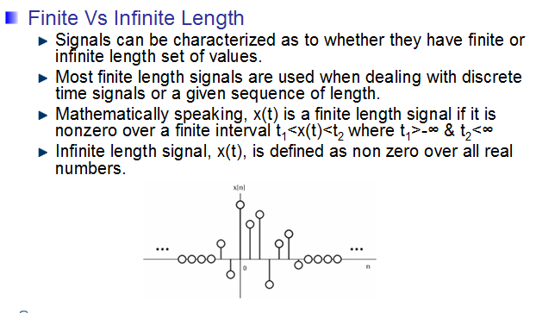
Classification of Signals
Finite Vs. Infinite Length
Dr. Ali J. Abboud

Slide 40
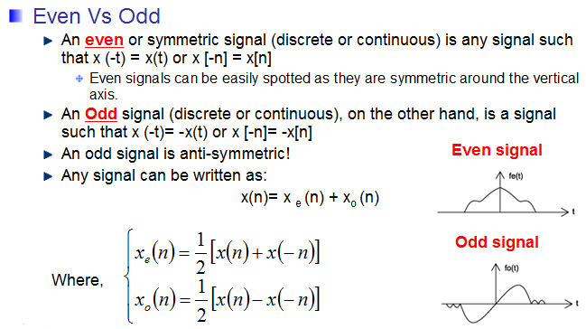
Classification of Signals
Even Vs. Odd
Dr. Ali J. Abboud

Slide 41
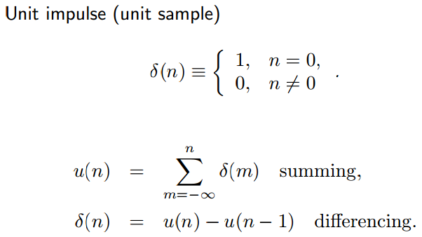
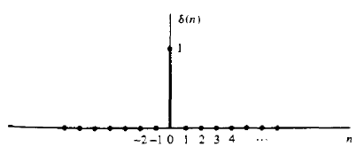
Basic Digital Sequences (Signals)
Dr. Ali J. Abboud

Slide 42
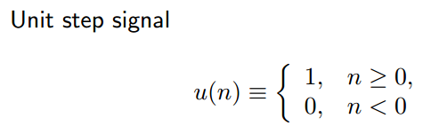
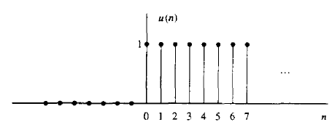
Basic Digital Sequences (Signals)
Dr. Ali J. Abboud

Slide 43

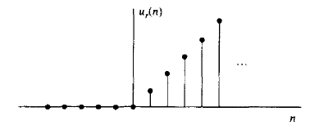
Basic Digital Sequences (Signals)
Unit Ramp Signal
Dr. Ali J. Abboud

Slide 44

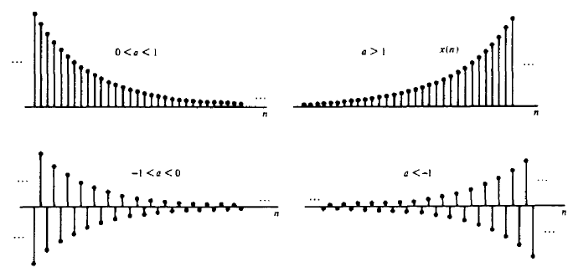
Basic Digital Sequences (Signals)
Exponential Signal
Dr. Ali J. Abboud

Slide 45
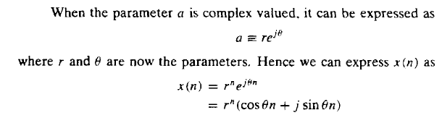
Basic Digital Sequences (Signals)
Exponential Signal
Dr. Ali J. Abboud

Slide 46
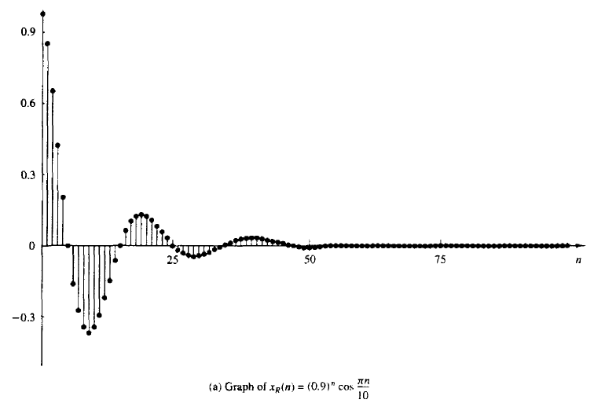
Basic Digital Sequences (Signals)
Exponential Signal
Dr. Ali J. Abboud

Slide 47
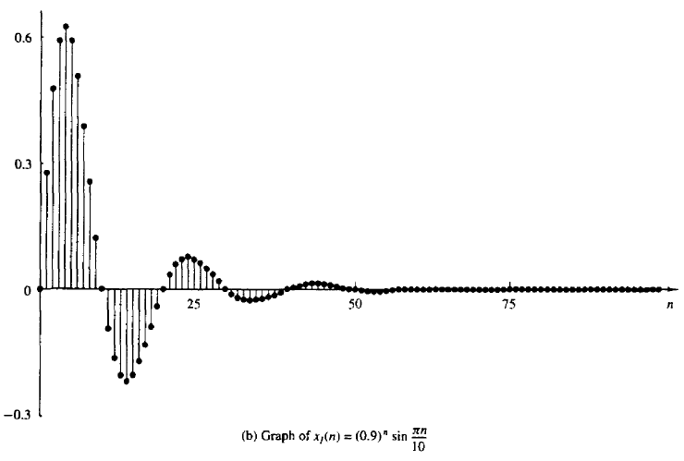
Basic Digital Sequences (Signals)
Exponential Signal
Dr. Ali J. Abboud

Slide 48
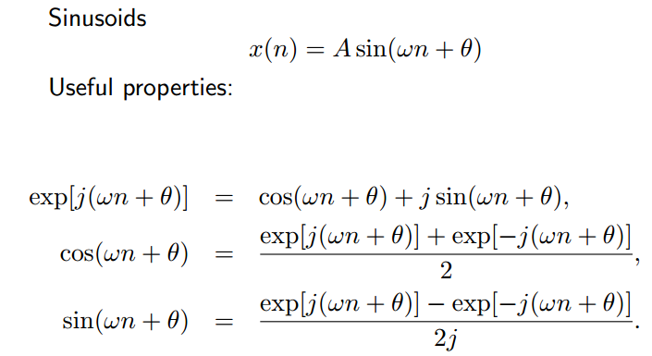
Basic Digital Sequences (Signals)
Sinusoids Signal
Dr. Ali J. Abboud

Slide 49
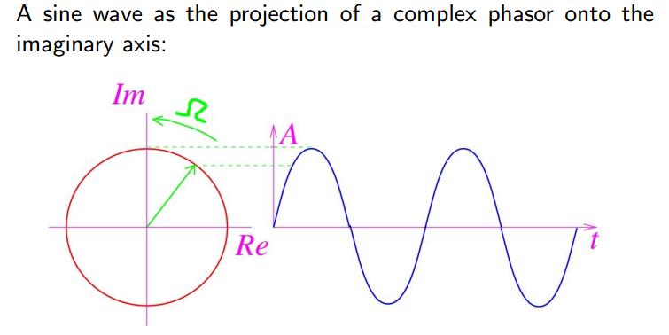
Basic Digital Sequences (Signals)
Sinusoids Signal
Dr. Ali J. Abboud

Slide 50
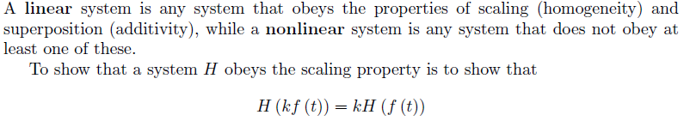
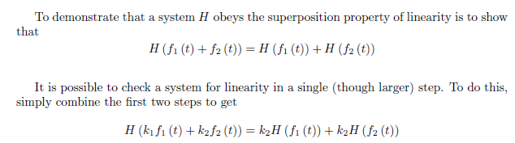
Classification of DSP Systems
Linear Vs. Non-linear Systems
Dr. Ali J. Abboud

Slide 51

Classification of DSP Systems
Linear vs. Non-linear Systems
Dr. Ali J. Abboud

Slide 52

Classification of DSP Systems
Linear vs. Non-linear Systems
Dr. Ali J. Abboud

Slide 53


Classification of DSP Systems
Time Invariant vs. Time Variant
Dr. Ali J. Abboud

Slide 54

Classification of DSP Systems
Time Invariant vs. Time Variant
Dr. Ali J. Abboud

Slide 55


Classification of DSP Systems
Casual vs. Noncasual
Dr. Ali J. Abboud

Slide 56

Classification of DSP Systems
Stable vs. Nonstable
Dr. Ali J. Abboud

Slide 57

Classification of DSP Systems
Stable vs. Nonstable
Dr. Ali J. Abboud

Slide 58

Classification of DSP Systems
Memoryless System
Dr. Ali J. Abboud

Slide 59

Characterization of Digital Filters
Recursive and Nonrecursive Digital Filters
A recursive system is one in which the output y(n) is dependent on one or more of its past outputs (y(n-1), y(n-2)G) while a non recursive system is one in which the output is independent of any past outputs .e.g. feedforward system having no feedback is a non recursive system.
Dr. Ali J. Abboud

